Slide 1
Computer Graphics:
Curves

Slide 2
Topics
What is a curve and its type?
Parametric Curve
Parametric & Geometric Continuety
Spline Curve
HERMITE Spline Curve
Bezier Spline Curve
B-Spline Curve

Slide 3
Curves & its Presentation
When we think about curve following geometric figure comes into mind
But Curve is more than this! Definition:
Lines joining a set of points cont.
Travel one point to another without any gap
Definition: A curve is a set of infinite points in which each point has two neighbours except end points

Slide 4
Curves & its Presentation
Example of curves
Types:
Explicit
A mathematical function y = f(x) can be plotted as a curve. Such a function is the explicit representation of the curve. The explicit representation is not general, since it cannot represent vertical lines and is also single-valued. For each value of x, only a single value of y is normally computed by the function
Implicit
Implicit curve representations define the set of points on a curve by employing a procedure that can test to see if a point in on the curve. Usually, an implicit curve is defined by an implicit function of the form, f(x,y)=0
A common example is the circle, whose implicit representation is
x² + y² - R² = 0

Slide 5
Curves & its Presentation
Types:
3. Parametric Curve
Curves having parametric form are called parametric curves. The explicit and implicit curve representations can be used only when the function is known. In practice the parametric curves are used. A two-dimensional parametric curve has the following form −
P(t) = f(t), g(t) or P(t) = x(t), y(t)
The functions f and g become the (x,y) coordinates of any point on the curve, and the points are obtained when the parameter t is varied over a certain interval [a, b], normally [0, 1].
P(t=0) P(t=0.8) P(t=1)
(x0,y0) (x,y) (x1,y1)
P(x,y)=(1-t)P0 + tP1
x = (1-0.8)*x0 + 0.8*x1 = 0.2*x0 + 0.8*x1 y= (1-0.8)*y0 + 0.8*y1 = 0.2*y0 + 0.8*y1

Slide 6
Curves & its Presentation
Types:
3. Parametric Curve
Curves having parametric form are called parametric curves. The explicit and implicit curve representations can be used only when the function is known. In practice the parametric curves are used. A two-dimensional parametric curve has the following form −
P(t) = f(t), g(t) or P(t) = x(t), y(t)
The functions f and g become the (x,y) coordinates of any point on the curve, and the points are obtained when the parameter t is varied over a certain interval [a, b], normally [0, 1].
P(t=0) P(t=0.8) P(t=1)
(x0,y0) (x,y) (x1,y1)
P(x,y)=(1-t)P0 + tP1
x = (1-0.8)*x0 + 0.8*x1 = 0.2*x0 + 0.8*x1 y= (1-0.8)*y0 + 0.8*y1 = 0.2*y0 + 0.8*y1

Slide 7
Design of Curves
Types:
1. Piece-wise linear: Join points by line (linearly joined) : ex: y=mx+c
but it is not smooth and not realistic.
2. Piece-wise Polynomial: Join points with polynomial (non-linear( curve. Ex: y = x³ + x² + 6 polynomial with degree=3 needs 4 points to draw. Remember y=mx+c is a polynomial with degree=1 needs 2 points. Use 4-5 points gives the best result. For 4 point curve called cubic

Slide 8
Parametric & Geometric Continuity
Quality of curve means how much is it smooth or continuous
Parametric Continuity: Checks the continuity when join two parametric curve
Last point of P joins the first point of Q
To check it use the following methods
Zero Order Parametric Continuity (C⁰): Satisfy the following conditions
P(1) = Q(0)
Last point of P and 1st point of Q must be same.
First Order Parametric Continuity (C¹):
Satisfy the following conditions
P’(1)= Q’ (0)
The tangent at Last point of P and 1st point of Q must be same.
2nd Order Parametric Continuity (C²): Satisfy the following conditions P”(1)= Q”(0) and P’(1)= Q’ (0)
For C² it must satisfy C⁰ and C¹.
t=0
t=1
t=1
t=0
P(t)
Q(t)
P(t)
Q(t)
Not Zero Order PC P(1) ≠ Q(0)

Slide 9


Parametric & Geometric Continuity
Geometric Continuity: Checks the continuity according to the shape when join two curves
t=0
To check it use the following methods
B
1. Zero Order Geometric Continuity (G⁰): Same as C⁰
P(1) = Q(0)
t=1
t=1 A
t=0
P(t) Q(t)
2. First Order Geometric Continuity (G¹): Satisfy the following conditions
A’(1) ∞ B’ (0)
A: Last point of P and B: 1st point of Q.
Both tangent must be the same direction, C¹ => C¹ but G¹ ≠> C¹
Let A(x_{p}, y_{p}) and B(x_{q}, y_{q})
3. 2nd Order Parametric Continuity (G²): Satisfy the following conditions
P”(1) ∞ Q”(0)

Slide 10
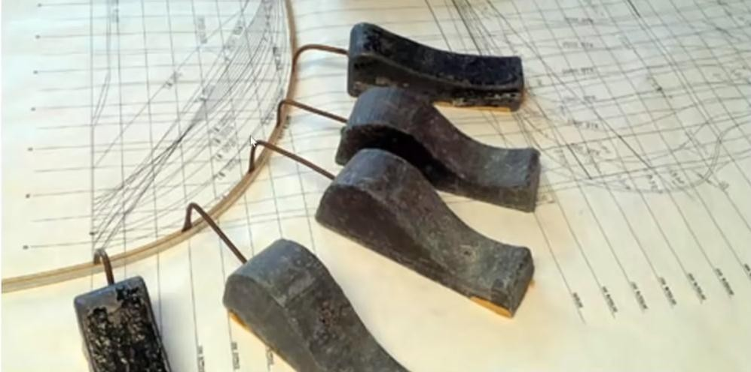
Spline Curves
Spline Curve: It is a strip of Balsha tree used to design a ship using ducks. It is a type of curve in which control points control the shape of the curve.
Types
1. Interpolation Spline Curve: It passes through the control points. Example of this type of curve is HERMIT curve
P(t)
2. Approximation Spline Curve
A curve that passes near to the control points but not necessarily passes through these points. Example Biezer Curve.
P(t)

Slide 11

Hermite Spline Curves
Hermite Spline Curve:
It is Interpolation spline curve
It uses cubic polynomial function (uses 4 points)
It uses two position vector (end-points), P1 & P2
It uses two tangent vector (in which position curve is moving) at end points, R1 & R2
P₂
R₂
R₁
t=0
P₁
P
3
P
4
P(t)
t=1
Let Q(t) is the curve at point [x(t), y(t), z(t)] Then we can write in matrix form
Here C=M.G
where M: Basis M(confirms C¹ & C² continuity
G: Geometric Vector Matrix
R₁(t=0)=P₁’ & R₂(t=1)=P₂’

Slide 12






Hermite Spline Curves
P₂
R₂
R₁
t=0
P₁
P₃
P₄
t=1
P(t)
The above four equations can be written as
H=Hermite Blending

Slide 13
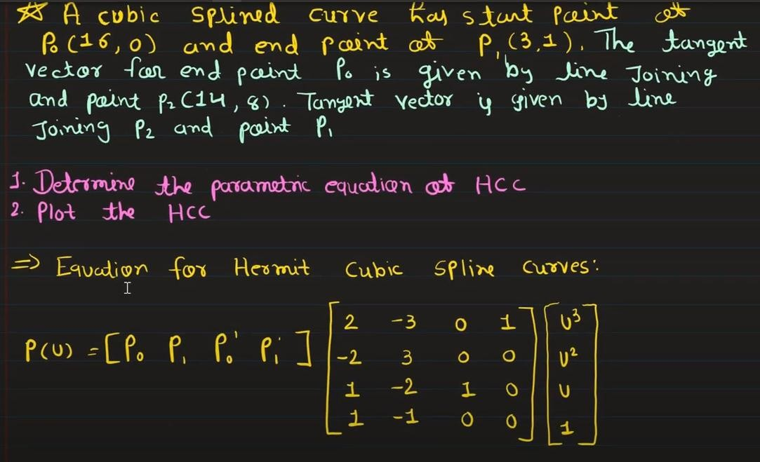
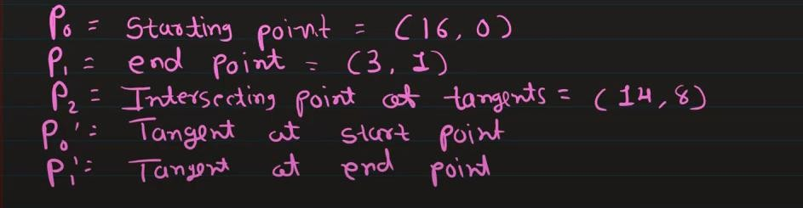
Hermite Curve: Example
P2(14,8)
P1(3,1)
P0(16,0)

Slide 14
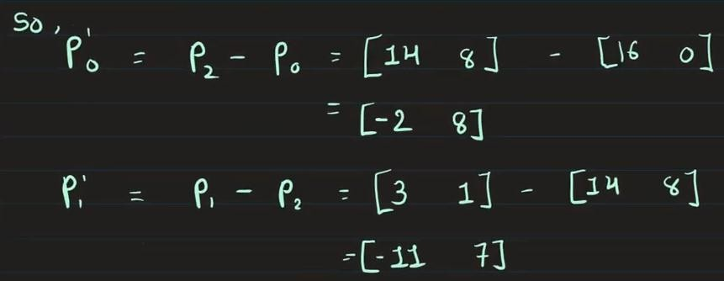
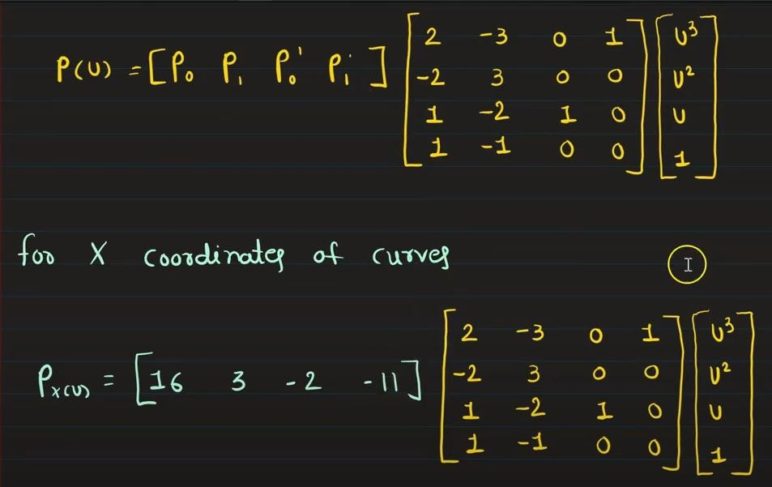

Hermite Curve: Example contd
P2(14,8)
P1(3,1)
P0(16,0)
P0=(16.0)
P1=(3,1)
P’0=(16,0)
P’1=(-11,7)

Slide 15
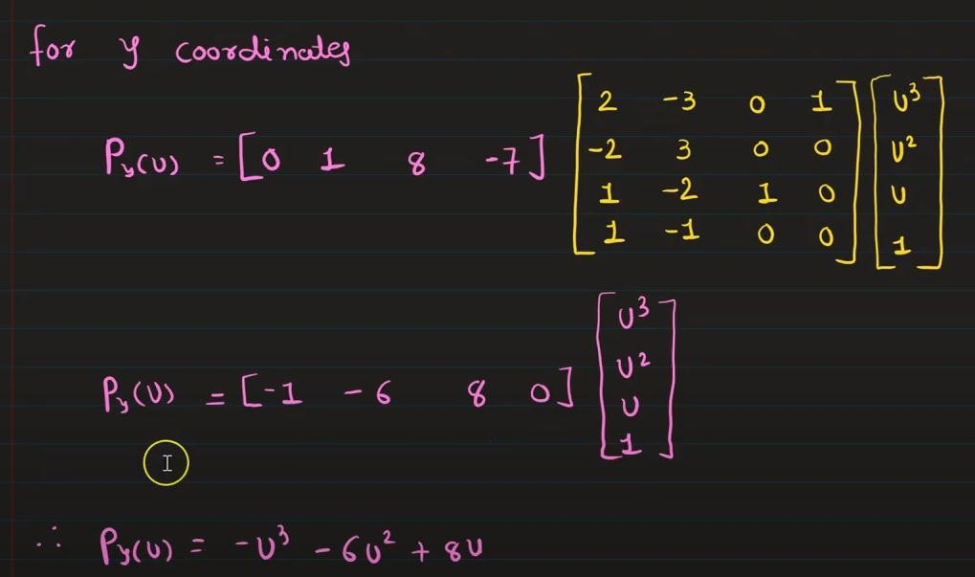
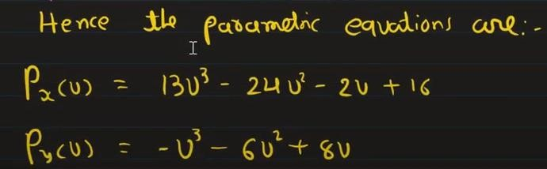
Hermite Curve: Example contd
P2(14,8)
P1(3,1)
P0(16,0)
P0=(16.0)
P1=(3,1)
P’0=(16,0)
P’1=(-11,7)

Slide 16
Bezier Curves
P₂
Convex-hull
Properties of Bezier Curve
P₁
It passes first and last points
The curve must be contained in the convex hull (connecting control points) of the control points
The control points control the shape
The degree of polynomial is one less than Control points.
It exhibits global control means if any control points moves then whole shape of the curve changed.
P₀
P₃
t=1
t=0
P₁
P₂
If control points=2 then degree=1 then polynomial is linear
P₃
t=1
t=0
If two control points=3 then degree=2 then polynomial is quadratic
P1 moved then shape changed
If two control points=4 then degree=3 then polynomial is cubic

Slide 17

Bezier Curves
P₁
t=1
Let consider 2 control points P₀ and P₁ then Any point L₀ between P₁ and P₂
L₀
t=x
Consider 3 control points P₀ and P₁ and P₂
t=0
P₀
t=1
P₁ t=0
P₁
t=1 t=0 L₀
t=x2
At t=x, calculated point at P P line is L , at
0 1 0
point P₁P₂ line is L₁ and at point AB line is
t=x1
Q
Q . The points L , L and L changed with
L₁
0
0 0 1 2
Q
L
1
the value of t. The final curve follows the
0
t=x2
t=x2
P₂
t=1
t=x1
t=0
point Q₀.
L
0
t=x1
P₂
P₀
P₀
t=0
Curve at t=x1
t=0
Curve at t=x2
t=1 t=0 L₀
t=x2
t=1 t=1
Q₁
For 4 control points P₀ ,P₁ , P₂ and P₃
Q₀
t=0
C₀
L
1
P₂
P₀
t=1 t=0
Curve with 4 control points
t=0

Slide 18
Bezier Curves
Prob: Design a Bezier curve controlled by 4 points P0(1,1), P1(2,3), P2(4,3) and P3(6,4).
Soln:
For 4 Control Points (CP) P₀ ,P₁ , P₂ and P₃ Degree of polynomial, n=4-1=3
The equation of Bezier Curve for 4 CPs is
4
3
P₃
P
2
P
1
Solving for x
𝑥₀ = 1, 𝑥₁ = 2, 𝑥₂ = 4, 𝑥₃ = 6
2
1
𝑃_{𝑥} 𝑢 = 𝑥₀(1 − 𝑢)³+3𝑥₁𝑢(1 − 𝑢)²+3𝑥₂𝑢² 1 − 𝑢 + 𝑥₃𝑢³
P₀
𝑃 𝑢 = (1 − 𝑢)³+6𝑢(1 − 𝑢)²+12𝑢² 1 − 𝑢 + 6𝑢³
𝑥
Solving for y 𝑦₀ = 1, 𝑦₁ = 3, 𝑦₂ = 3, 𝑦₃ = 4
𝑃_{𝑦} 𝑢 = 𝑦₀(1 − 𝑢)³+3𝑦₁𝑢(1 − 𝑢)²+3𝑦₂𝑢² 1 − 𝑢 + 𝑦₃𝑢³
1 2 3 ⁴
5 6
𝑃_{𝑦} 𝑢 = (1 − 𝑢)³+9𝑢(1 − 𝑢)²+9𝑢² 1 − 𝑢 + 4𝑢³
u | P_{x}(u) | P_{y}(u)
0.0 | 1 | 1
0.2 | 1.712 | 1.984
0.4 | 2.616 | 2.632
0.6 | 3.664 | 3.088
0.8 | 4.808 | 3.496
1.0 | 6 | 4
4
3
P₃
P₂
u=1
P
1
u=0.8
u=0.6
u=0.4
u=0.2
u=0
2
1
P₀
1 2 3 ⁴
5 6

Slide 19
B-Spline Curves
Properties of B Spline Curve
It is an approximate Spline curve
It s local control curve by control points
The curves is divided into segments and any of control point (CP) affects only in the segment. The number of segment is obtained by
P₂
P₁
P₃
P₆
P₀
Seg=n-k+2 here n=total CP-1, k=no. of control points in a segment (2 ≤ k ≤ CP) Let k=3 then seg=(7-1)-3+2=5
P₅
Q(u)
P₄
Segment Control Points
Q₁ P₀P₁P₂
Q₂ P₁P₂P₃
Q₃ P₂P₃P₄
Q₄ P₃P₄P₅
Q₅ P₄P₅P₆
Degree of the polynomial =k-1=3-1=2 degree (k-1)
The curve will be piecewise polynomial of

Slide 20





B-Spline Curves
General equation of B Spline Curve
P₂
P₁
P₃
P₆
Where
Pi = control points u=parameter (0 ≤ u ≤ n-k+2)
Q(u) has two values x(u) and y(u), then we can write
P₀
P₅
Q(u)
P₄
t_{i} = Joint Point at which piece of curve joins
i = (0 ≤ i ≤ n+k) t_{i} = 0 if i<k
t_{i} = i-k+1 if k< I <n t_{i} = n-k+2 if i>k

Slide 21

B-Spline Curves
P₂
P₁
P₃
P₅
Example : Here CP=6, n=5 and k=3, the equation of the curve
P₀
Q(u)
P₄
Here u=n-k+2=4, so range of u=(0 ≤ u ≤ 4)
t_{i} = Joint Point at which piece of curve joins
i = (0 ≤ i ≤ n+k=8)
Then we need to find [t_{0 ,} t_{1 ……} t₈ ] t_{i} = 0 if i<k
t_{i} = i-k+1 if k< i <n t_{i} = n-k+2 if i>k
t₀ = 0 as 0<3 (i<k)
t₁ = 0 as 1<3 (i<k)
t₂ = 0 as 2<3 (i<k)
t₃ = 1 as 3 ≤ 3<5 (k ≤ i<n) t₄ = 4 as 4>3 (i>k)
t₅ = 4 as 5>3 (i>k)
t₆ = 4 as 6>3 (i>k)
t₇ = 4 as 7>3 (i>k)
t₈ = 4 as 8>3 (i>k)

